Slide 1
Multus CNI
References:
https://www.redhat.com/en/blog/using-the-multus-cni-in-openshift

Slide 2
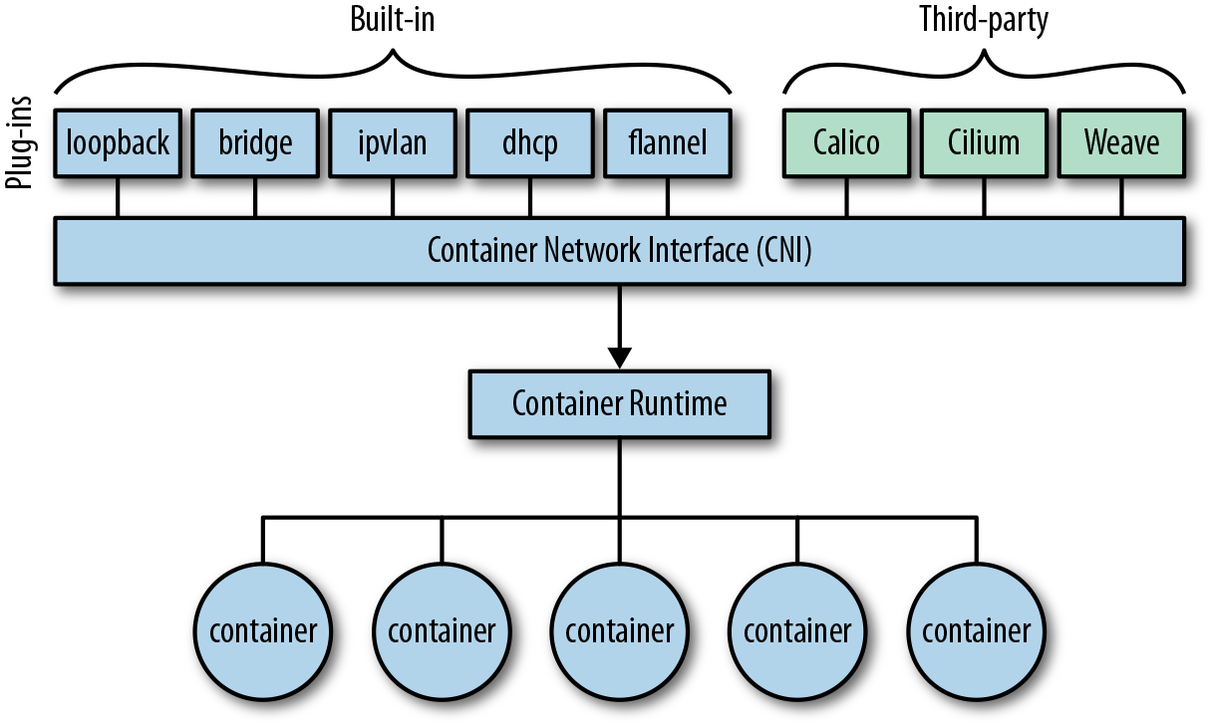
CONTAINER NETWORK INTERFACE CNI
Provides a pluggable application programming interface to configure network interfaces in Linux containers.
Eg: Multus CNI (meta-plug-in)
  A CNI plug-in that can run other CNI plug-ins.
  Works like a wrapper that calls other CNI plugins for attaching multiple network interfaces to pods in OpenShift (Kubernetes).

Slide 3
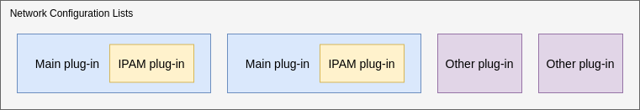
Network Configuration List
Multiple plug-ins can be configured for a single container using Network Configuration Lists.

Slide 4
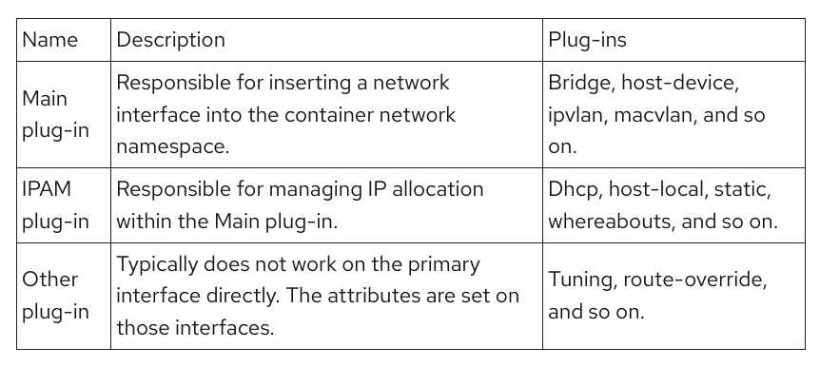

Slide 5
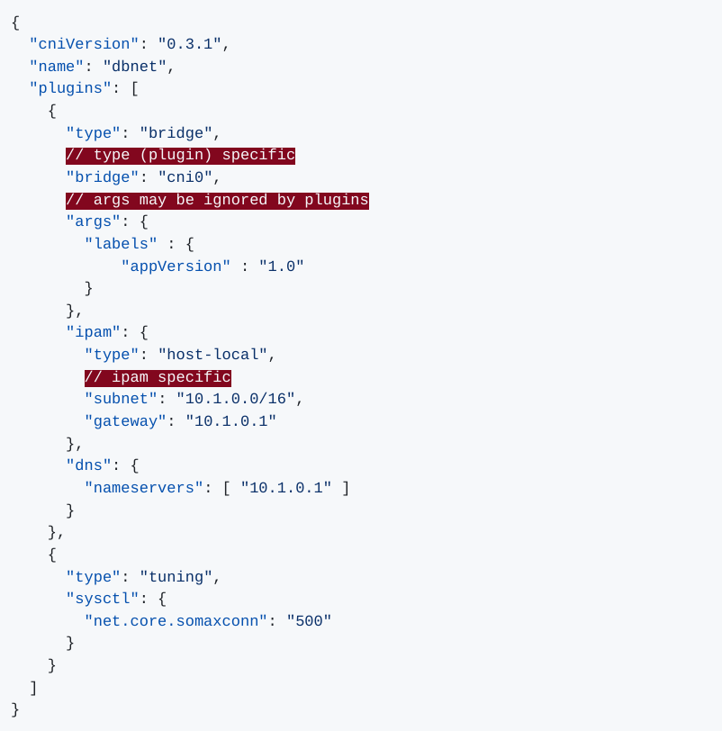
Network Configuration List

Slide 6
How Does Multus Work ?
Additional network configurations based on Multus are managed by the Cluster Network Operator (CNO) in OpenShift.
Multus CNI is implemented through the NetworkAttachmentDefinition CR (CustomResource) being led by the Network Plumbing Working Group.
Reconciliation is facilitated according to .spec.additionalNetworks in the networks.operator.openshift.io.
Even though you can also directly create NetworkAttachmentDefinition CR without CNO, it is recommended that you use the CNO for the centralized management of your additional networks.

Slide 7
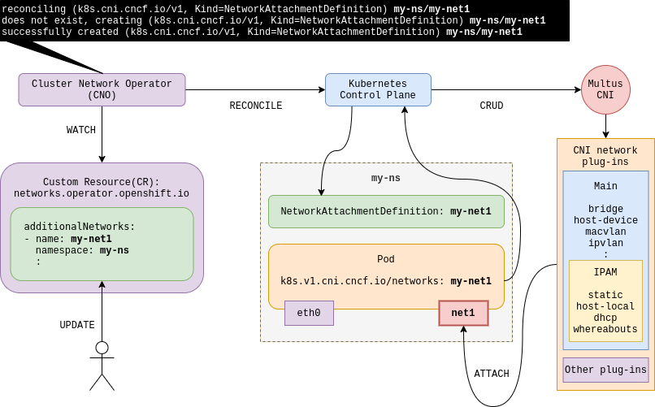

Slide 8
Main Plug-ins With IPAM
The Main CNI plug-in creates and configures network interfaces for pods.
IPAM CNI plug-in can be combined with any main plug-in

Slide 9
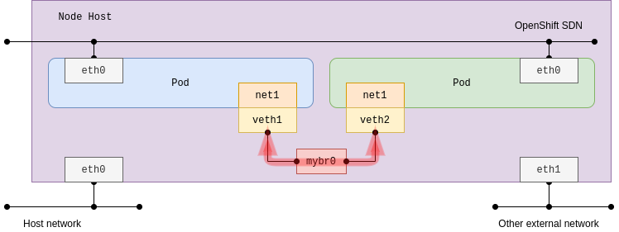
Bridge
Acts as a network switch between multiple pods on the same node host.
a bridge interface is created that does not link any physical host interface.
No connections to any external networks including other pods on the other nodes

Slide 10
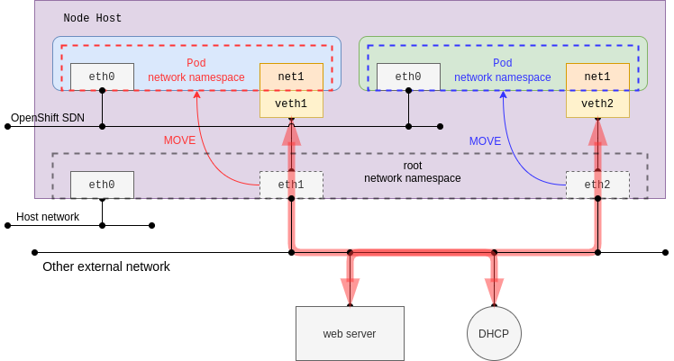
Host-device
Configure an additional host-device network to enable pods access to a physical Ethernet network device on the host system.

Slide 11
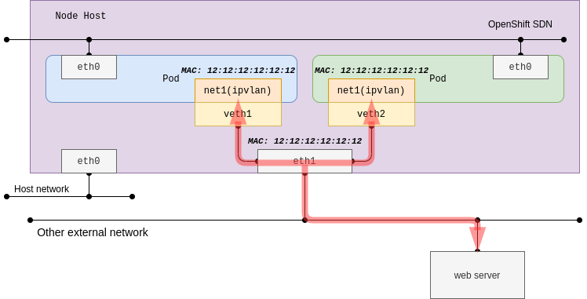
Ipvlan
Configure an additional IPVLAN-based network to enable pods on a host to have different IP addresses with the same MAC address as the host's physical device

Slide 12
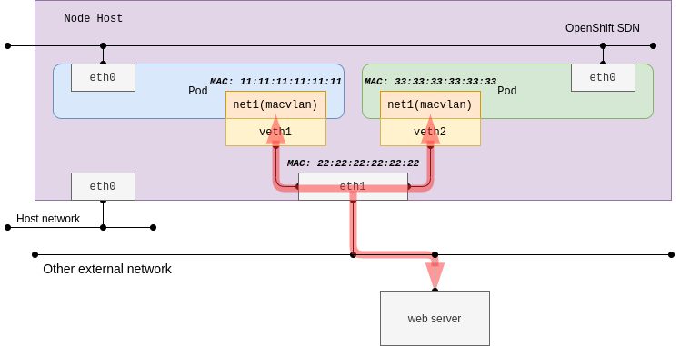
Macvlan
Configure an additional MACVLAN-based network to enable pods on a host to communicate with other hosts and their pods by using a physical network interface.
Unique Mac Address

Slide 13
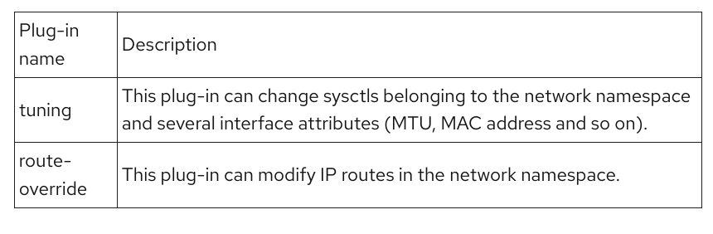
Other Plug-ins
Plug-ins usually set attributes of interfaces not handling the primary interface directly

